Slide 1
Introduction
Angular is a platform and framework for building client applications in HTML and TypeScript.
Angular is itself written in TypeScript.
It implements core and optional functionality as a set of TypeScript libraries that you import into your apps.

Slide 2
NgModules
The basic building blocks of an Angular application are NgModules, which provide a compilation context for components.
NgModules collect related code into functional sets; an Angular app is defined by a set of NgModules.
An app always has at least a root module that enables bootstrapping, and typically has many more feature modules.

Slide 3
Component
Components define views, which are sets of screen elements that Angular can choose among and modify according to your program logic and data.
Every app has at least a root component.
Components use services, which provide specific functionality not directly related to views.
Service providers can be injected into components as dependencies, making your code modular, reusable, and efficient.

Slide 4
Component
Every Angular application has at least one component, the root component that connects a component hierarchy with the page DOM.
Each component defines a class that contains application data and logic, and is associated with an HTML template that defines a view to be displayed in a target environment.
The @Component decorator identifies the class immediately below it as a component, and provides the template and related component-specific metadata.

Slide 5
Benefits of Component-based Architecture
As you can see, this component-based architecture makes our applications more organized and maintainable. Plus, we can potentially reuse these components in various parts of an application or in an entirely different application

Slide 6
Modules
Every Angular app has a root module, conventionally named AppModule, which provides the bootstrap mechanism that launches the application.
An app typically contains many functional modules.
Like JavaScript modules, NgModules can import functionality from other NgModules, and allow their own functionality to be exported and used by other NgModules.
For example, to use the router service in your app, you import the Router NgModule.

Slide 7
First Angular 4 Application Cont…
Install the latest version of Node.
Node comes with a tool called Node Package Manager or NPM
NPM is used to install Angular CLI.
Run the following command to install Angular CLI
npm install -g @angular/cli
The -g flag stands for global. If you don’t put -g here, Angular CLI will be installed only in the current folder, and it’s not going to be accessible anywhere else.

Slide 8
First Angular 4 Application Cont…
To create a new Angular project use the following command:
ng new hello-world
Angular CLI can be accessed using ng.
Angular CLI will generate a new project called “hello-world” and store it in a folder with the same name

Slide 9
First Angular 4 Application Cont…
Run the following commands in the terminal:
cd hello-world
npm install
ng serve
The command npm install will install all the dependencies of the application.
The command ng serve compiles the application and hosts it using a lightweight web server.
Access the application at http://localhost:4200.

Slide 10
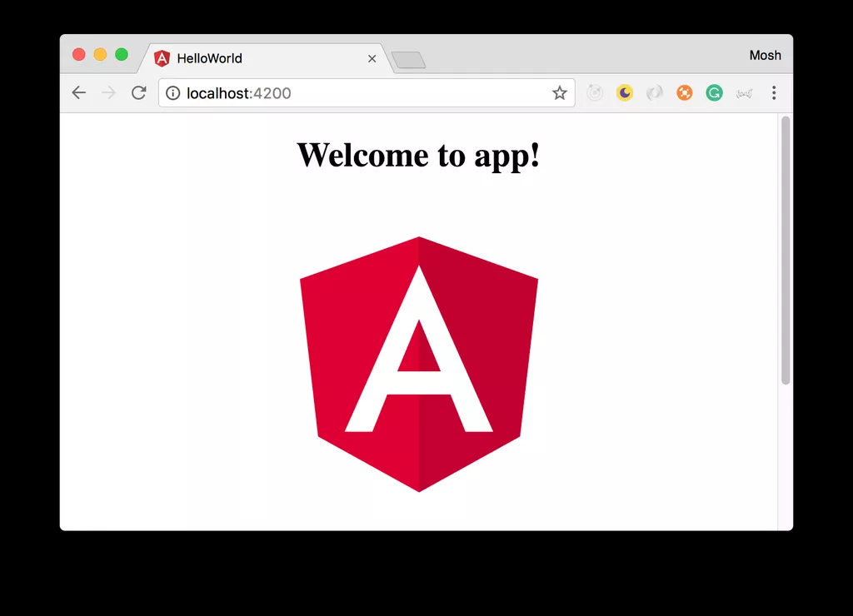
First Angular 4 Application
Open the browser and navigate to this address http://localhost:4200.

Slide 11
Structure of Angular Projects Cont…
Inside the generated folder, the following top-level folders are present:
e2e: includes end-to-end tests.
node_modules: all the third-party libraries that our project is dependent upon.
src: the actual source code of our Angular application. 9.9% of the time you’ll be working with the files inside the src folder.
angular-cli.json: a configuration file for Angular CLI. This file is used to import third-party stylesheets or define additional environments (eg testing environment) for our application.

Slide 12
Structure of Angular Projects Cont…
package.json: a standard file for Node-based projects. It contains metadata about our project, such as its name, version as well as the list of its dependencies.
protractor.conf.js: Protractor is a tool for running end-to-end tests for Angular projects.
karma.conf.js: Karma is a test runner for JavaScript applications. This file contains some configuration for Karma.

Slide 13
Structure of Angular Projects Cont…
tsconfig.json: includes setting for the TypeScript compiler.
tslint.json: includes the settings for TSLint which is a popular tool for linting TypeScript code.
It checks the quality of our TypeScript code based on a few configurable parameters.
This is especially important in a team environment to ensure that everyone follows the same conventions and produces code of the same quality.

Slide 14
Angular Component in Action
Open the src/app folder
app.component.css
app.component.html
app.component.spec.ts
app.component.ts
app.module.ts

Slide 15
Angular Component in Action
Each component in an Angular project is physically implemented using four files:
A CSS file: where we define all the styles for that component. These styles will only be scoped to this component and will not leak to the outside.
An HTML file: contains the markup to render in the DOM.

Slide 16
Angular Component in Action
A spec file: includes the unit tests.
A TypeScript file: where we define the state (the data to display) and behavior (logic) of our component.
An app.module.ts file is also present. This file defines the root module of our application and tells angular how to assemble the app.

Slide 17
Creating a Component Cont…
Generating a Component Using Angular CLI
ng g c product
g is short for generate, c is short for component and product is the name of our component.
Inside the src/app folder, a new folder product is generated. Expand this folder
product.component.css
product.component.html
product.component.spec.ts
product.component.ts

Slide 18
Creating a Component
Open product.component.ts
import { Component, OnInit } from '@angular/core';
@Component({
selector: 'app-product',
templateUrl: './product.component.html',
styleUrls: ['./product.component.css']
})
export class ProductComponent implements OnInit {
constructor() { }
ngOnInit() {
}

Slide 19
Creating a Component
we have a TypeScript class called ProductComponent.
What is a Class?
A class is a fundamental building block of many object-oriented programming languages. It’s a container for a bunch of related functions and variables.
In product.component.ts, there is a class called ProductComponent.
This class has 2 functions (methods): constructor and ngOnInit.

Slide 20
Creating a Component
Constructor is a reserved keyword in TypeScript. A method by that name is a special method in a class.
This method is called automatically when we create an instance of that class.
ngOnInit is a special method in Angular.
Angular calls this method when it creates an instance of this component and displays it to the user in the browser

Slide 21
Component Metadata
we implement a component using a TypeScript class.
But a class on its own is just a class. It only includes some data and logic for a view. It doesn’t include any HTML markup or CSS styles.
In order to attach these to this class, we need to promote this class to a component.
We can do this by using the @Component() decorator function on top of this class

Slide 22
import { Component, OnInit } from '@angular/core';
@Component({
selector: 'app-product',
templateUrl: './product.component.html',
styleUrls: ['./product.component.css']
})
export class ProductComponent {
}

Slide 23
It takes an object with the following properties:
selector
templateUrl
styleUrls
You’ve seen the selector in action. It associates a new HTML element to this component.
The other 2 properties (templateUrl and styleUrls) are self-explanatory. They specify the path to the HTML template and CSS file(s) for this component.

Slide 24
Property binding & Event binding
<p>{{ title }}</p>
<p>{{ itemCount }}</p>
Event Binding
Similar to property binding, we have another concept in Angular called event binding. With property binding, we bind properties of DOM elements to fields/properties in our component. With event binding, we bind events of DOM elements (such as clicks) to methods in our component. So, for example, when the user clicks on a button, a method in our component will be called.
<p>{{ title }}</p>
<p>{{ itemCount }}</p>
<button (click)="addItem()">Add</button>

Slide 28
Angular4

Slide 29

Course Objective
To understand and develop rich interactive Web Application using Angular4.

Slide 30
Session Plan
Introduction to Angular4
Typescript
Angular4 Architecture
Module
Component
Template
Metadata
Data Binding
Directives
Services
Dependency Injection
Routers
Forms
Using a Service

Slide 31
References
For more information about architecture:
- https://angular.io/guide/architecture
For Typescript
- https://www.learnhowtoprogram.com/javascript/angular-js/typescript-
introduction-and-installation

Slide 32
Introduction to Angular4
Angular4 is the most advanced framework for the web.
It empowers developers to build applications that live on the web, mobile, or the desktop.
It aims to simplify both the development and testing of such applications by providing a framework for client-side model–view–controller (MVC) and model–view–view-model (MVVM) architectures, along with components commonly used in rich internet applications.
Angular4 has rebuilt the entire framework in TypeScript,
Angular4 combines declarative templates, dependency injection, end to end tooling, and integrated.

Slide 33
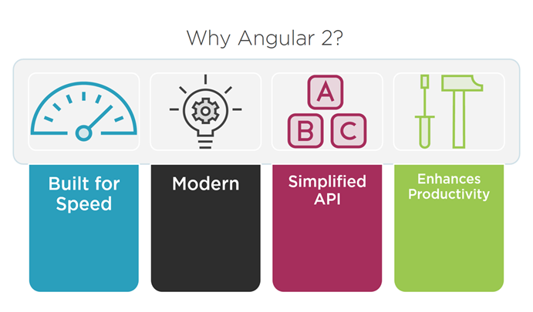
Why Angular4?
It makes mobile apps easier to handle things and improves performance, load time, etc.
Angular4 is component driven. The complexity of the core AngularJS will be removed, resulting better performance.
Angular4 targets ES6 and make harder for any hacks or workarounds which ensures the security of the particular business domain.

Slide 34
Angular2 Features
Browser Compatibilty:
- It supports IE 9, 10, 11, Firefox, Chrome, Safari, Android 4.1 & Microsoft Edge.
Cross platform:
- It can run on desktop, mobile, Android, iOS, etc.
Development
It provide full support for CS5, TypeScript, Dart, ES6, other languages that compile to JavaScript.
Mobile Support
Angular 4.0 is mobile oriented architecture. There are libraries i.e. Native script which helps mobile development fast.
TypeScript
TypeScript(TS) is used heavily in Angular 4. Google currently using DART for coding. DART or TypeScript can be used for Angular 4
No $Scope in Angular4 Angular 4 is not using $scope anymore to glue view and controller

Slide 35
Typescript
Typescript is basically a compiled type language with a strongly typed layer in conjunction with JavaScript.
Typescript allows to write a class, interface, and module statements just like in Java or C# which boosts the performance of the web and mobile solution as the code written in Typescript are less inclined to run-time errors.
For more about Typescript
- https://www.learnhowtoprogram.com/javascript/angular-js/typescript-
introduction-and-installation
TypeScript code:
var message:string =“Hello World”
Console.log(“message”)
Typescript saved with the extension .ts
Compiled JavaScript Code:
var message =“Hello World”
Console.log(“message”)
The file is compiled to Test.js

Slide 36
Angular4 Architecture
The major 8 blocks of Angular4 architecture:
Module
Component
Template
Metadata
Data Binding
Directive
Services
Dependency Injection

Slide 37
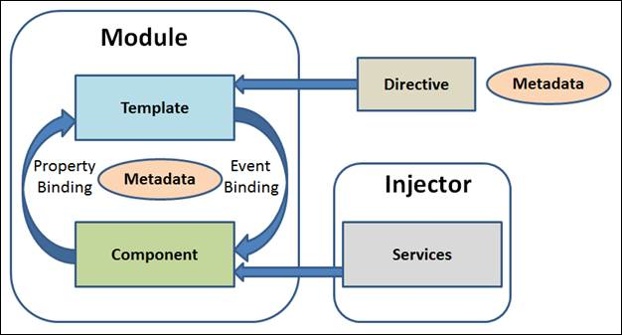
Angular4 Architecture

Slide 38
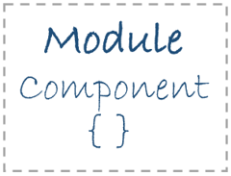
Module
Module is very similar to a class.
A module can be described by a block of code which is used to perform a particular single task.
Angular4 has a feature of modularity, where a single application is built by separating it in many modules.
Export statement is used to export component class from a module.
export class AppComponent
{
….
}

Slide 39
Module (cont..)
App
Modules
Module
code
export
Module
code
import
Module
code
Module
code

Slide 40
Module (cont.)
NgModule decorator to defines the modules.
import {NgModule} from ‘@angular/core’;
@NgModule({
imports: [ …],
declarations: [ … ],
bootstrap: [ … ]
})
export class AppModule{}
Decorator

Slide 41
NgModule
declarations | - the view classes that belong to this module. Angular has three kinds of view classes: components, directives, pipes.
exports | the subset of declarations that should be visible and usable in the component templates of other modules.
imports | other modules whose exported classes are needed by component templates declared in this module.
providers | - creators of services that this module contributes to the global collection of services; - they become accessible in all parts of the app.
Bootstrap | the main application view, called the root component, that hosts all other app views. - Only the root module should set this bootstrap property.

Slide 42
Module (cont.)
Sample app.module.ts file
import { NgModule } from '@angular/core';
import { BrowserModule } from '@angular/platform-browser';
import { AppComponent } from './app.component';
import { SampleComponent } from "./sample.component";
@NgModule({
imports: [ BrowserModule ],
declarations: [ AppComponent,SampleComponent ],
bootstrap: [ AppComponent ]
})
export class AppModule { }

Slide 43
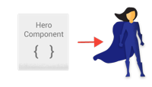
Component
Components are the most basic building block of an UI in an Angular application.
@Component is used to register a component and only one component is used per DOM element.
Component decorator allows you to mark a class as an Angular component and provide additional metadata that determines how the component should be processed, instantiated and used at runtime.

Slide 44
Component (cont..)
App
Component
Module
COMPONENT
export
Module
COMPONENT
import
Module
METADATA
+
CLASS
Module
METADATA
+
CLASS

Slide 45
Component (cont.)
The component would look like.
import {Component} from ‘@angular/core’;
@Component({
selector: ‘ ’,
template: ‘ ’,
})
export class AppComponent{}
Decorator

Slide 46
Component (Cont..)
Sample app.component.ts file
import { Component } from '@angular/core';
@Component({
selector: 'my-app',
template: `<h1>Hello {{name}}</h1>
<sample-app></sample-app> `,
})
export class AppComponent { name = 'Jamuna'; }

Slide 47
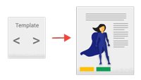
Template
Template is the main part which justifies the look of the component.
It can be said that the view of the component is defined using template.
To display value, add template expression in code
<div>
Your name is : {{name}}
</div>

Slide 48
Template (Cont..)
Template example
import { Component } from '@angular/core';
@Component({
selector: 'my-app',
template: `<h1>Hello {{name}}</h1>`,
})
export class AppComponent { name = 'Jamuna'; }

Slide 49

Directive
Directives are custom HTML attributes used to prolong power of HTML.
To create a directive, @Directive decorator is applied on connected metadata of the class.
Directive decorator allows you to mark a class as an Angular directive and provide additional metadata that determines how the directive should be processed, instantiated and used at runtime.
For More Information about directive
https://angular.io/api/core/Directive
import {Directive} from '@angular/core';
@Directive({
selector: 'my-directive',
})
export class MyDirective {
}

Slide 50

Metadata
Metadata is majorly used to extend the functionality of the class.
Metadata can be attached to TypeScript using a decorator.
For example, to define any component in Angular application,
use metadata of the class (i.e. @Component decorator)

Slide 51

Metadata (cont..)
- The metadata in the @Component tells Angular where
to get the major building blocks you specify for the
component.
- The template, metadata and the component together
describes a view.
- @Injectable, @Input and @Output are a few of the
more popular decorators.

Slide 52
Data Binding
The most powerful feature, Data Binding, is the connection bridge between Model and View.
It gets automatically synchronized.
Angular 4.0 supports four types of binding –
Property Binding
Event Binding
Interpolation
Two-Way Binding

Slide 53
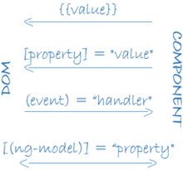
Data Binding (Cont..)
It displays the hero.name property value within the <li>element.
The [hero] property binding the value of selectedHero from the parent HeroListComponent to the hero property of the child HeroDetailComponent.
Interpolation
The HeroListComponent example:
<li>{{hero.name}}</li>
<hero-detail [hero]="selectedHero"></hero-detail>
<li (click)="selectHero(hero)"></li>
Property Binding
The (click) event binding calls the component's selectHero method when the user clicks a hero's name.
Event Binding

Slide 54
Data Binding (Cont..)
It combines property and event binding in a single notation, using the ngModel directive.
Two-way Binding
The HeroListComponent example:
<input [(ngModel)]="hero.name">
In two-way binding, a data property value flows to the input box from the component as with property binding. The user's changes also flow back to the component, resetting the property to the latest value, as with event binding.

Slide 55
Data Binding (Cont..)
Data Binding Demos

Slide 56
Getting Started
my-app
e2e
app.e2e-spec.ts
app.po.ts
tsconfig.e2e.json
node_modules/...
src/...
.angular-cli.json
.editorconfig
.gitignore
karma.conf.js
package.json
protractor.conf.js
README.md
tsconfig.json
tslint.json
For information about quickstart directives:
https://angular.io/guide/quickstart
To set up development environment:
npm install
To start the application:
npm run serve
npm start
Quick Start Template

Slide 57
Demos

Slide 58
Using Pipes
import {Component} from 'angular2/core' @Component({ selector: 'hero-birthday', template: `<p>The hero's birthday is {{ birthday | date }}</p>` }) export class HeroBirthday { birthday = new Date(1988,3,15); // April 15, 1988 }

Slide 59

Services
Services are used when a single functionality is used commonly in various modules of the application.
Basically, is used to share the data and behavior within the application.
Service has no base class.
Commonly used services are logging service, data service, message service, etc.

Slide 60
Services (Cont..)
Module
COMPONENT
Module
COMPONENT
data
server
Module
COMPONENT

Slide 61

Dependency Injection
To attach the functionality of components at runtime, dependency injection is used.
As objects are passed as dependencies, it makes dependencies configurable - removing its hard-coded dependencies.
With dependency injection, components can be easily maintainable, reusable and testable.

Slide 62
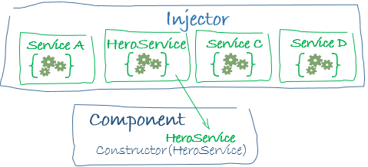
Dependency Injection (Cont..)
constructor(private service:HelloService){}
When Angular creates a component, it first asks an injector for the services that the component requires.
An injector maintains a container of service instances that it has previously created. If a requested service instance is not in the container, the injector makes one and adds it to the container before returning the service to Angular.
When all requested services have been resolved and returned, Angular can call the component's constructor with those services as arguments. This is dependency injection.

Slide 63
Dependency Injection (Cont..)
Points to remember about dependency injection:
Dependency injection is wired into the Angular framework and used everywhere.
The injector is the main mechanism.
An injector maintains a container of service instances that it created.
An injector can create a new service instance from a provider.
A provider is a recipe for creating a service.
Register providers with injectors.

Slide 64
Routers
The Angular Router enables navigation from one view to the next as users perform application tasks
Enter a URL in the address bar and the browser navigates to a corresponding page.
Click links on the page and the browser navigates to a new page.
Click the browser's back and forward buttons and the browser navigates backward and forward through the history of pages you've seen.
import { RouterModule, Routes } from ‘@angular/router’;

